Slide 1
Step-by-Step Guide to Research
By Jessica Cowden for Mahoney Library
9/16/2025
This work is openly licensed via CC BY-NC 4.0

Slide 2

Navigate to Mahoney Library home page
Do a web search for “mahoney library” in Google or your preferred search engine
Saint Elizabeth University should be the first result
Or, click here: https://www.steu.edu/academics/mahoney-library/index.html

Slide 3
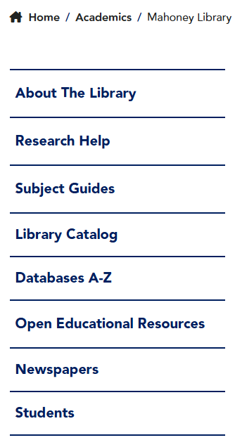
Locate subject resources
In the sidebar navigation, click on “Subject Guides”

Slide 4
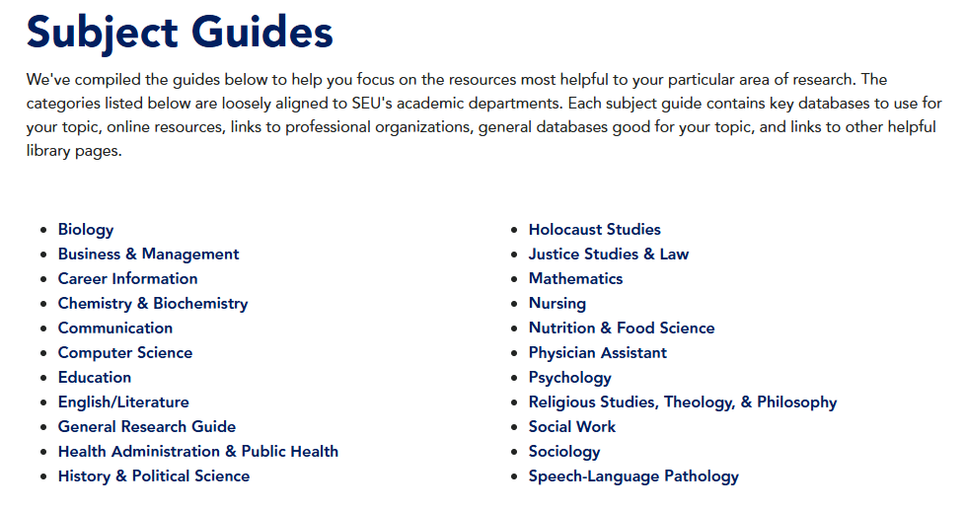
Click on your subject
From the sidebar navigation or the subject guide index page, click on the subject that best fits your needs
In this example, we will look at sociology

Slide 5
Format of the subject guides (explanation)
Each subject guide has a few key databases most relevant to the topic at the top of the page
Below that are various useful websites - these may be resources on a specific topic within the subject, statistic sites, study resources, or professional organizations
Next are additional resources related to the subject, encyclopedias and reference works, links to books and educational videos, and citation style guides

Slide 6
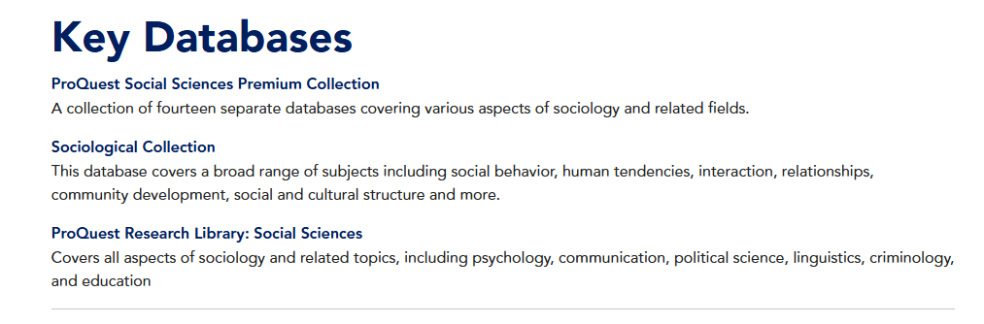
Choose a database
Each database will have a short description underneath it explaining what kinds of sources it contains. Some will be collections, which search in multiple databases at once
Click on the title of whichever database you’d like to search in

Slide 7
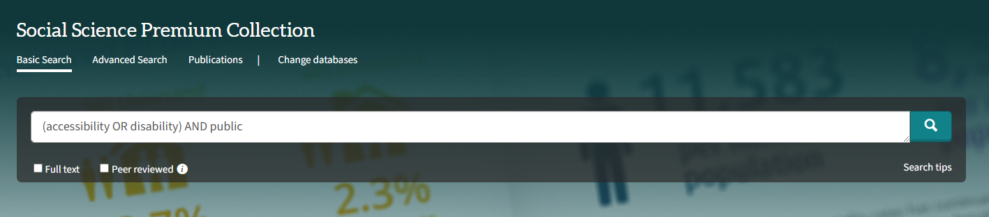
Enter your search terms
Once in the database, type your search (keywords and Boolean Operators) into the search bar and hit “enter” on your keyboard
Visit the Advanced Search Tips library page for help creating a search
In this example, we’ll try to find sources about the accessibility of public spaces for people with disabilities

Slide 8
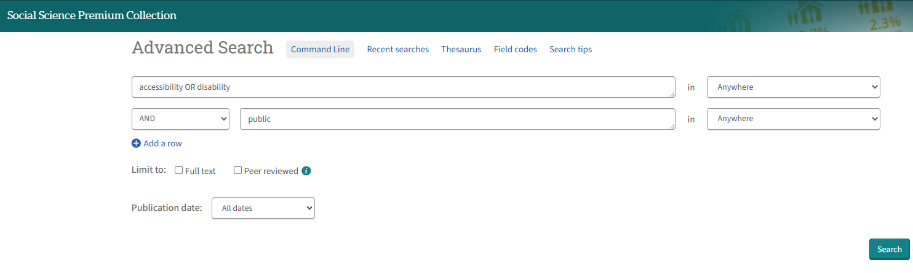
Enter your search terms (alternative)
You can also use the advanced search page
This can specify where your terms should appear in the results, and apply filters at the same time
The search string is created for you, but make sure to put OR clauses on the same line

Slide 9
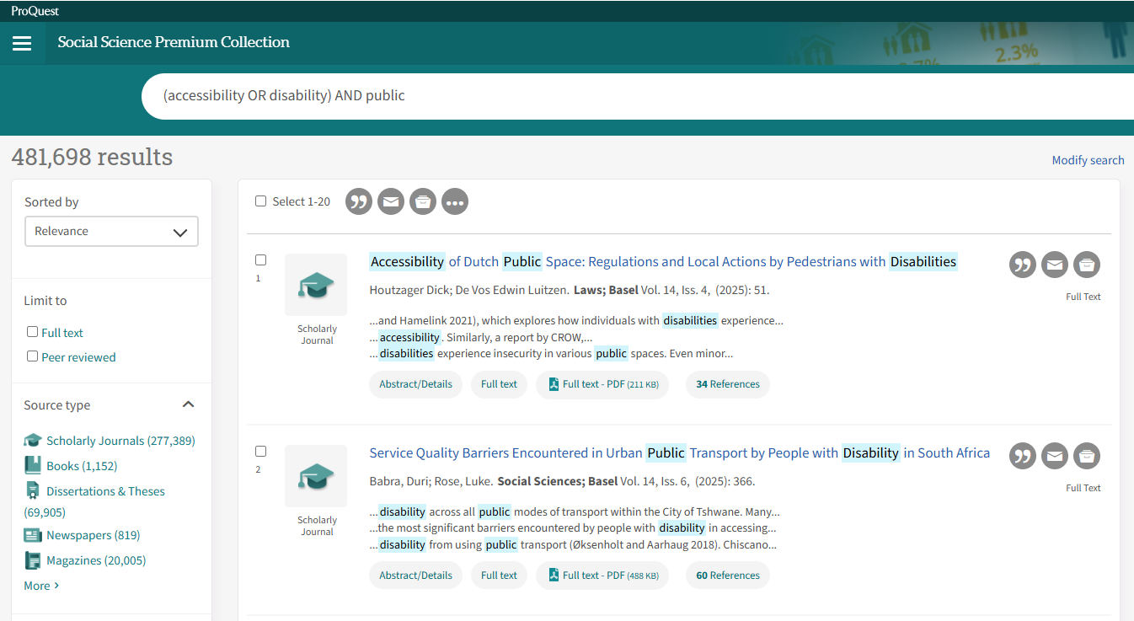
View results
Once you click “search”, the database will return all sources it has that fit your terms - our example search returned 481,698 results

Slide 10
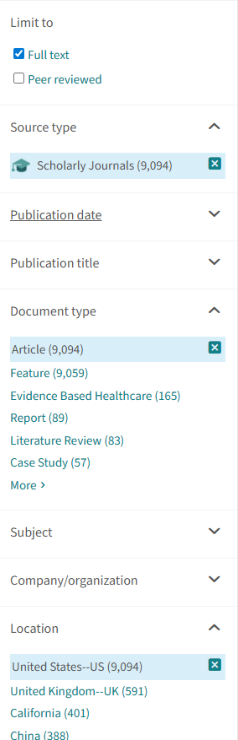
Apply filters
480,000 results is way too many for us to look through, and many of them will be irrelevant
So, we will apply filters to weed some out. You can do this using a sidebar, a “modify search” button, or an “advanced search” button
If using a sidebar, each option may have a number next to it - this tells you many results there will be if you apply that filter

Slide 11
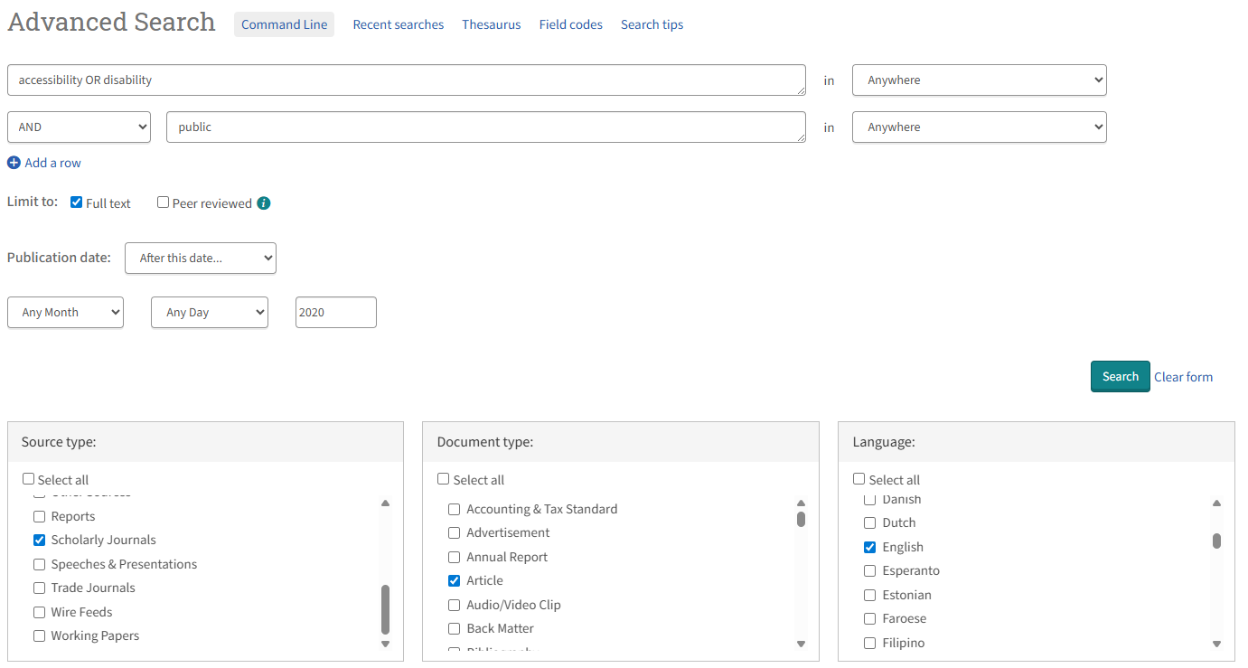
Advanced search screen with filters

Slide 12
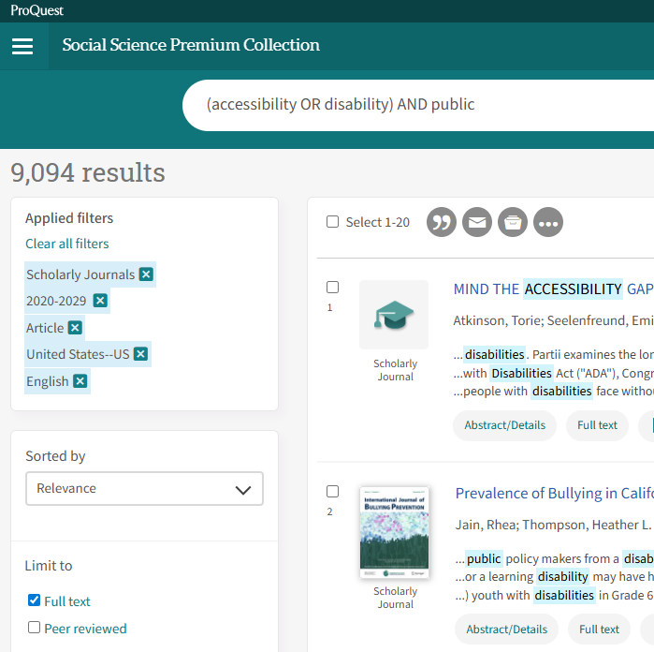
View results
In this example, I have limited results to full text only, and applied filters so that only English articles from the United States published in scholarly journals since 2020 will appear
Now, I only have 9,094 potential sources

Slide 13
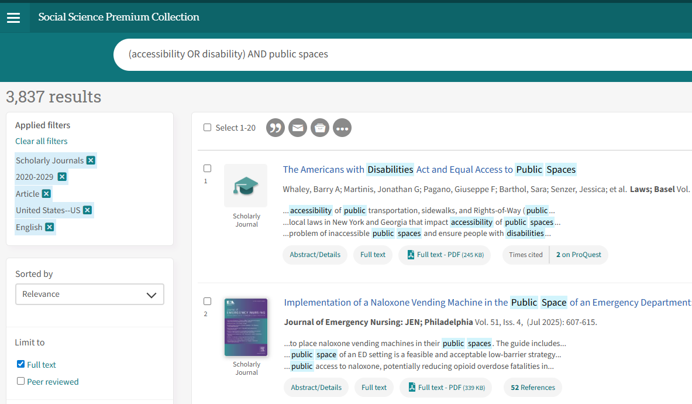
Refine your search
After browsing the first two pages of results, it seems this search isn’t getting me exactly what I want. Let’s change our search to say public spaces instead of just public
There are two or three results on the first page that look good, but most of these aren’t what I’m looking for

Slide 14
Refine, refine, and refine again
Getting to a set of sources that are exactly what you’re looking for may take a few tries. Play around with different keywords, Boolean Operator combinations, parenthesis, truncation, and quotation marks. Visit the Advanced Search Tips library page for help
You can also get ideas for new keywords based on the articles that are relevant. The next slide shows the various searches I did to get to an ideal set of articles: many of the new keywords I tried came from trying to replicate what was in the articles I liked
After quite a bit of fine-tuning, I was able to create a search string and filter combination that narrowed my results down to 207

Slide 15
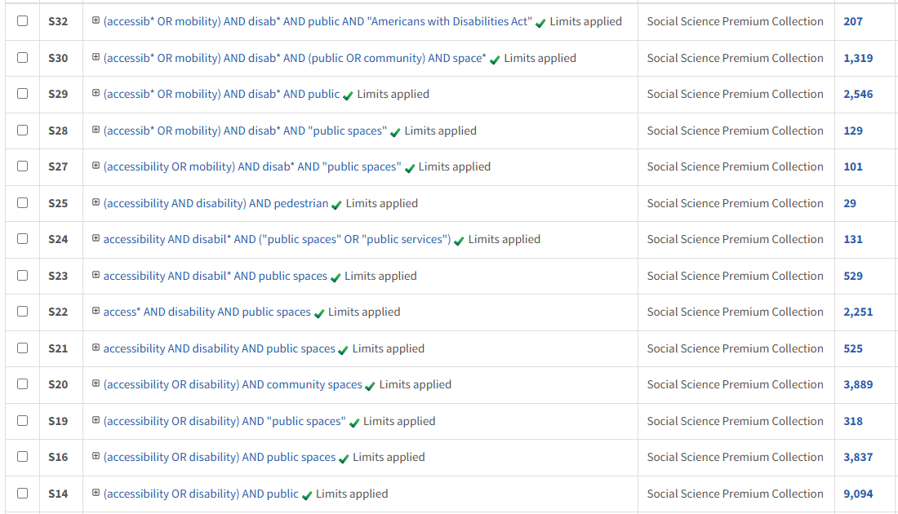
Refinement process
All filters stayed the same from step 9.
Some search numbers are missing: I deleted repetitive ones so it’d fit on a slide

Slide 16
Final search
It didn’t take as long to do all those searches as you might have thought. It took me about 20 minutes to get from (accessibility OR disability) AND public spaces to (accessib* OR mobility) AND disab* AND public AND "Americans with Disabilities Act"
However, I am a professional at this!
While you’re still working out the best search string, don’t worry about reading abstracts or evaluating sources. After each search attempt, I only looked at the article titles and brief blurbs on the results page to get an idea of how well the results matched my topic. If more than half the results weren’t quite what I was looking for, I changed the search string

Slide 17
Evaluating the sources (first round)
Once you have a set of results that matches your topic idea, it’s time to go through them individually
In this initial phase, you only want to look at the abstract, the introduction, and the conclusion/references
Check that the source meets all your basic criteria, focuses on your topic, and has a good amount of sources
If the source does not meet this, leave it and go back to the results page
If the source still looks good, move on to the next evaluation step

Slide 18
Evaluating a source (second round)
If a source meets your requirements from the first evaluation round, skim the whole article to get a better idea of how the article might support your topic
You may uncover essential details while skimming the article that didn’t come up in the first evaluation round
This round is also where you will use either the CRAAP test or the SIFT method to determine the quality of the source. Visit the Evaluating Sources library page to learn about these
If the source still looks good after a closer look, pass it on to the next evaluation stage

Slide 19
Evaluating a source (final round)
Once you’ve determined that a source is of good quality, it’s time to actually read the source in its entirety
In this final step, you are looking for specific things to pull out for your own paper
Does the author provide data that supports your idea?
Is there a quote that stands out to you?
Do the authors findings or arguments help you develop your topic, ideas, hypothesis, or paper?
Cite away! If an argument stands out but isn’t particularly quotable, paraphrase it with a citation afterward

